Slide 1
Internet Speed Test

Slide 2
Internet Speed Test Lab
Internet Service Types
Recall the different options for Internet access
Fiber Optic
Cable
DSL
Wireless
The speed will (most likely) decrease as you move down the above list. For this lab, you'll test multiple computers on different networks.

Slide 3
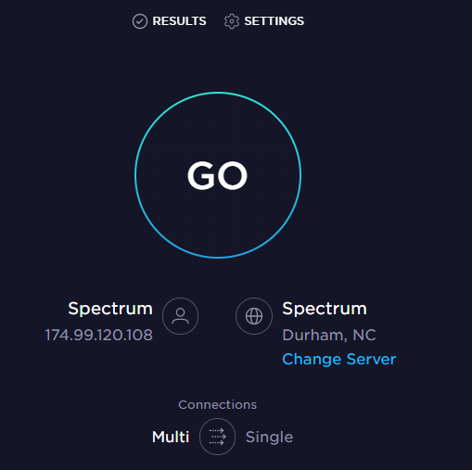
Internet Speed Test Lab
Speedtest website
On your computer, go to www.speedtest.net
The speedtest.net (by Ookla) internet speed test will provide:
The ping
The download speed
The upload speed
Your Internet service provider (ISP)
Your computer’s IP address
www.speedtest.net’s testing tool

Slide 4
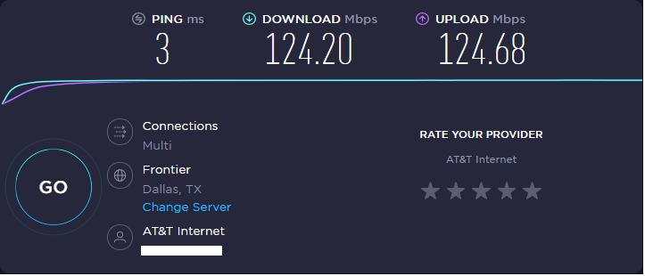
Internet Speed Test Lab
Click on the Go button
This will start the test (it will take around 30 seconds to run the test)
This is where the IP address is listed
Click on Go to begin the internet speed test

Slide 5
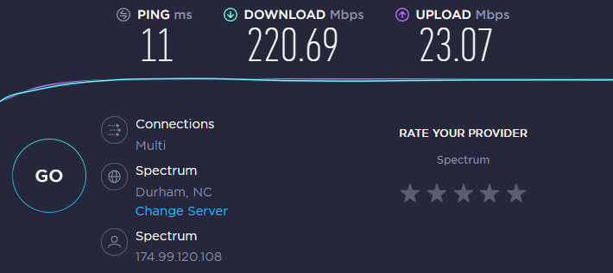
Internet Speed Test Lab
Viewing the results
The download, how quickly data is being sent from their server to your computer
The upload, how quickly data is being sent from your computer to their server
The ping, or the milliseconds (ms) it takes for a message to go from your computer to their server and back)
Location of the server for the test
Your ISP, or Internet Service Provider
The IP Address of your computer

Slide 6
Internet Speed Test Lab
Your Turn - What are your results?
What were the following when you ran the test:
The ping
The download speed
The upload speed
Your Internet service provider (ISP)
Your computer’s IP address

Slide 7
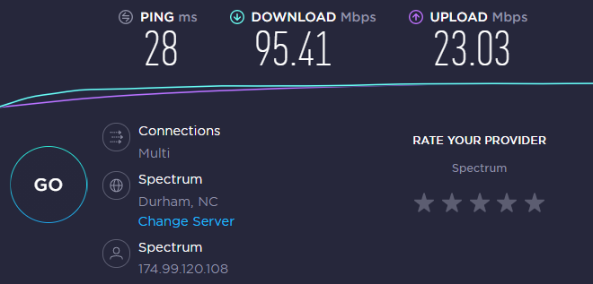
Internet Speed Test Lab
Test on a different device
Here is the original example test (wired) against a new example test (wireless)
Notice the difference in the download and ping speeds
Original Test
(wired)
New Test
(wireless)

Slide 8
Internet Speed Test Lab
Your Turn - Run the test on a different device/connection
Do you expect the speed to increase or decrease?
Difference devices/connections include the following:
Ethernet vs. wireless connections
Different devices (smartphone vs. laptop)
Different networks (School’s network vs. Cellular network)
Distance from a router (move further away)

Slide 9
Internet Speed Test Lab
Your Turn - Run the test on a different device/connection
What were the following when you ran the second test:
The ping
The download speed
The upload speed
Your Internet service provider (ISP)
Your computer’s IP address
Which device/connection was quicker?
Repeat this test on as many devices/connections as possible and compare the results

